Slide 1
PHP Basics
CSE 3100
Dept. of CSE

Slide 2
PHP
PHP is a script language and interpreter that is freely available and used primarily on Linux Web servers.
PHP, originally derived from Personal Home Page Tools
Now stands for PHP: Hypertext Preprocessor, which the PHP FAQ describes as a "recursive acronym."

Slide 3
What is PHP?
PHP stands for PHP: Hypertext Preprocessor
PHP is a server-side scripting language,
PHP scripts are executed on the server
PHP supports many databases (MySQL, Informix, Oracle, Sybase, Solid, PostgreSQL, Generic ODBC, etc.)
PHP is an open source software
PHP is free to download and use

Slide 4
Why PHP?
PHP runs on different platforms (Windows, Linux, Unix, etc.)
PHP is compatible with almost all servers used today (Apache, IIS, etc.)
PHP is FREE to download from the official PHP resource: www.php.net
PHP is easy to learn and runs efficiently on the server side

Slide 5
What is a PHP File?
PHP files can contain text, HTML tags and scripts
PHP files are returned to the browser as plain HTML
PHP files have a file extension of ".php", ".php3", or ".phtm

Slide 6
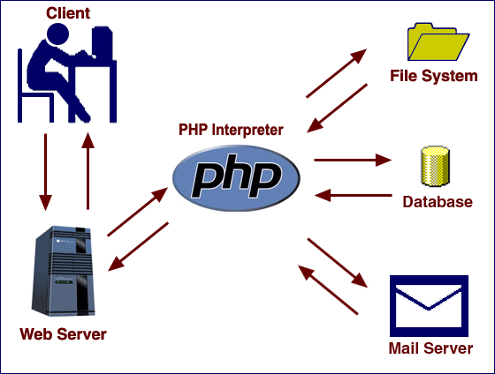
How PHP Works?
request of .php file is sent to a web server, which directs the request to the PHP interpreter.
the PHP interpreter processes the page
delivers a web page to the web server to return to the browser

Slide 7
Installing Web Server and PHP
We use a package for installing web server and PHP called XAMPP for windows
XAMPP version 1.7.3 includes:
Apache 2.2.14 (IPv6 enabled) + OpenSSL 0.9.8l
MySQL 5.1.41 + PBXT engine
PHP 5.3.1
phpMyAdmin 3.2.4
Perl 5.10.1
FileZilla FTP Server 0.9.33
Mercury Mail Transport System 4.72

Slide 8
Basic PHP Syntax
<html> <body> <?php echo "Hello World";
print "Hello World again";
//This is a comment /* This is a comment block */ ?> </body> </html>
Show basicphp.php

Slide 9
Variables in PHP
All variables in PHP start with a $ sign symbol.
$var_name = value; example:
Variable naming Rules:
A variable name must start with a letter or an underscore "_"
A variable name can only contain alpha-numeric characters and underscores (a-z, A-Z, 0-9, and _ )
A variable name should not contain spaces. If a variable name is more than one word, it should be separated with an underscore ($my_string), or with capitalization ($myString)
Show phpvar.php
<?php $txt="Hello World!"; $x=16; ?>

Slide 10
PHP strings and operators
String example:
<?php $txt1="Hello World!"; $txt2="What a nice day!"; echo $txt1 . " " . $txt2; ?>
Operators:
Basic all operators can be used in php as you can use in C or C++
Almost same expression style

Slide 11
PHP If...Else Statement
<?php $d=date("D"); if ($d=="Fri") echo "Have a nice eekend!"; else echo "Have a nice day!"; ?>
Show iflese.php

Slide 12
PHP Arrays
In PHP, there are three kind of arrays:
Numeric array - An array with a numeric index
$cars=array("Saab","Volvo","BMW","Toyota"); or
$cars[0]="Saab"; $cars[1]="Volvo"; $cars[2]="BMW"; $cars[3]="Toyota";
Associative array - An array where each ID key is associated with a value
$ages['Peter'] = "32"; $ages['Quagmire'] = "30"; $ages['Joe'] = "34";
Multidimensional array - An array containing one or more arrays

Slide 13
While Loops
In PHP, we have the following looping statements:
while - loops through a block of code while a specified condition is true
do...while - loops through a block of code once, and then repeats the loop as long as a specified condition is true
for - loops through a block of code a specified number of times
foreach - loops through a block of code for each element in an array
<?php $i=1; while($i<=5) { echo "The number is " . $i . "<br />"; $i++; } ?>
Show while.php

Slide 14
PHP Forms and User Input
Chunkify.html
<body>
<form action="chunkify.php" method="POST">
Enter a word: <input type="text" name="word" /><br />
How long should the chunks be?
<input type="text" name="number" /><br />
<input type="submit" value="Chunkify!">
</form>
</body>

Slide 15
PHP Forms and User Input
Chankify.php
<?php
$word = $_POST['word'];
$number = $_POST['number'];
$chunks = ceil(strlen($word)/$number);
echo "The $number-letter chunks of '$word' are:<br />\n";
for ($i=0; $i < $chunks; $i++) {
$chunk = substr($word, $i*$number, $number);
printf("%d: %s<br />\n", $i+1, $chunk);
}
?>

Slide 16
Self processing pages
One PHP page can be used to both generate a form and process it.
If the page shown in temp.php is requested with the GET method, it prints a form that accepts a Fahrenheit temperature.
If called with the POST method, however, the page calculates and displays the corresponding Celsius temperature.
Show temp.php

Slide 17
Sticky pages
Many web sites use a technique known as sticky forms, in which the results of a query are accompanied by a search form whose default values are those of the previous query.
Show tempsticky.php

Slide 18
Multiple selection
HTML selection lists, created with the select tag, can allow multiple selections.
To ensure that PHP recognizes the multiple values that the browser passes to a form-processing script, you need to make the name of the field in the HTML form

Slide 19
Validation
When you allow users to input data, you typically need to validate that data before using it or storing it for later use.
There are several strategies available for validating data.
The first is JavaScript on the client side.
However, since the user can choose to turn JavaScript off, or may even be using a browser that doesn't support it, this cannot be the only validation you do.

